Slide 1
BigDataStatMeth: Scalable Statistical Methods for Big Data in R and C++
Efficient computation on HDF5-stored datasets using R and Rcpp

Slide 2
Big Data in R - Limitations
Memory constraints
All data must fit in RAM; large datasets cause crashes or slowdowns
Speed and performance
Single-Threaded Execution; Slow for Iterative Tasks
Data I/O Bottlenecks
Inefficient file read/write for large data, standard formats are not optimized for big data
Scalability
Poor handling of datasets that exceed system memory
Parallelism
Requires manual effort; not default behavior

Slide 3
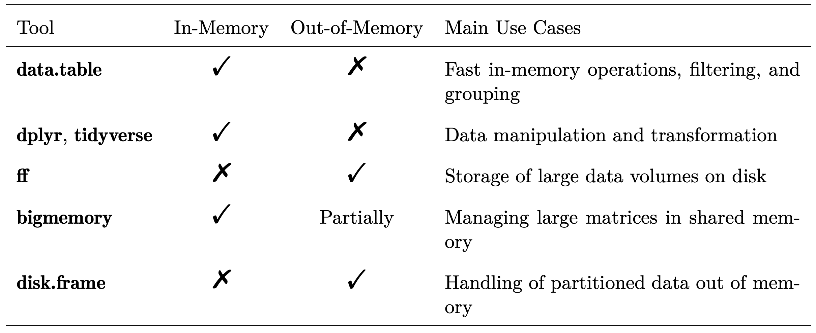
Tools for Big Data in R
Tool | In-Memory | Out-of-Memory | Main Use Cases
data.table | ✓ | ✘ | Fast in-memory operations, filtering and grouping
Dplyr, tidyverse | ✓ | ✘ | Data manipulation and transformation
ff | ✘ | ✓ | Storate of large data volumes on disk
bigmemory | ✓ | Partially | Managing large matrices in shared memory
disk.frame | ✘ | ✓ | Handling of partitioned data out of memory
bigstatr | ✘ | ✓ | R workflows with large numeric matrices

Slide 4
BigDataStatMeth - bigstatr
Feature | bigstatsr | BigDataStatMeth R-C++ API
Main Language | R | R and C++
Primary Data Structure | Filebacked Big Matrix (FBM) | HDF5 and in-memory matrices
On-Disk Support | FBM format | HDF5 format
In-Memory Support | ✘ | ✓
Parallel Computation | ✓ | ✓
Supported Matrix Ops | Scaling, SVD, PCA, regression, ML | SVD, matrix multiplication, block-wise operations
Focus / Use Case | Scalable statistical modeling in R | HPC-style matrix computations, genomics, algorithm dev
Extensibility | Moderate (within R) | High (C++ extendable, pluggable algorithms)
Interoperability (Python,etc) | ✘ | ✓ (via HDF5 and C++)

Slide 5
What is BigDataStatMeth?
A custom R/C++ library
Build to:
Efficiently handle large matrices stored in HDF5
Expose core numerical routines in both R and C++
Provide building blocks for:
Basic functions with vectors and matrices
Lineal Algebra Functions
Data Analyses
Provide a ready-to-use tool for the optimized development of new methods for big data

Slide 6
BigDataStatMeth Strategies in R
How get better performance and deal with big data in R
Core functionality implemented in C++
Optimized balance between speed (RAM) and scalability (disk)
Parallelized in R with a C++ backend using OpenMP
HDF5 used for efficient, hierarchical data storage
Used block-wise algorithms :
For scalable computation
To handle large datasets that don't fit into memory
To enable parallel processing
To work efficiently with disk-based storage

Slide 7



Why C++
How to work with Big Data in R
R language
Not ready to work with big datasets
Interpreted language - execution slow
C++ language
Compiled language - fast execution
How to work with C++ from R
sumR <- function(x) { total <- 0 for (i in seq_along(x)) { total <- total + x[i] } total }
cppFunction( double sumC( NumericVector x ) { int n = x.size(); double total = 0; for( int i=0; i<n; ++i ){ total += x[i]; } return total; } )
x <- runif(1e4) tiempo <- microbenchmark( sumC(x), sumR(x) )
Computing time to sum 10000 elements in R and C++
 | min | lq | mean | median | max
sumC(x) | 12.283 | 12.7465 | 22.78794 | 12.9740 | 737.096
sumR(x) | 371.169 | 409.2200 | 657.46140 | 453.6975 | 19065.275
Interconnection

Slide 8
Big data with C++ and Rcpp
Objects with data placed in memory
R current objects
Rcpp library from R-cran
C++ native objects
Algebra Libraries in Rcpp (C++ for R)
RcppEigen
Spectra
BLAS (Basic Linear Algebra Subprograms)
LAPACK (Linear Algebra Package)
Parallel Computing in Rcpp
OpenMP
Rcpp
R Objects
C++ Matrix

Slide 9
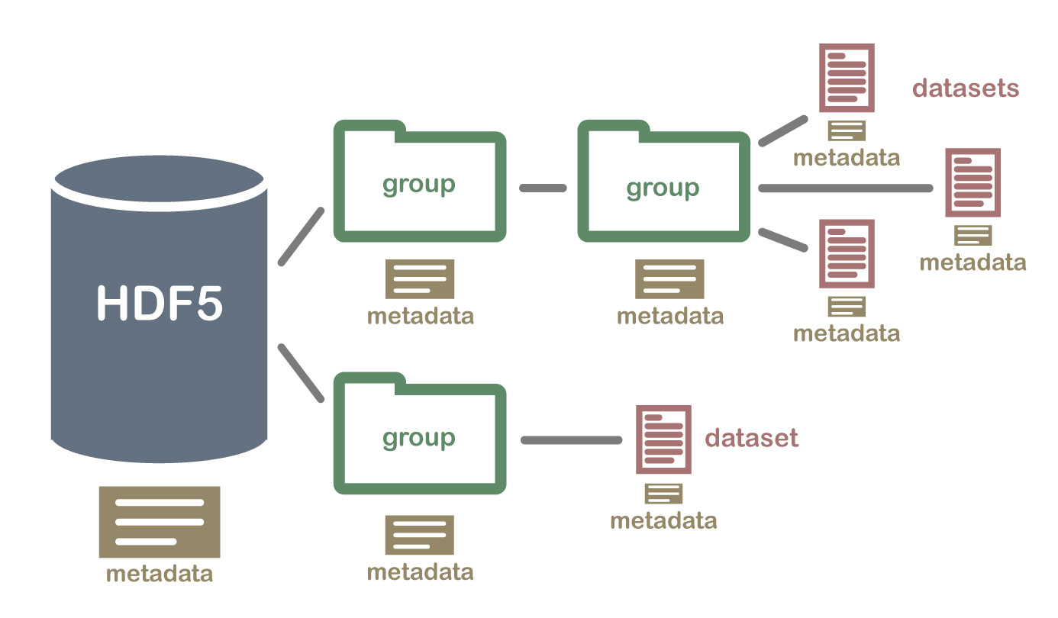
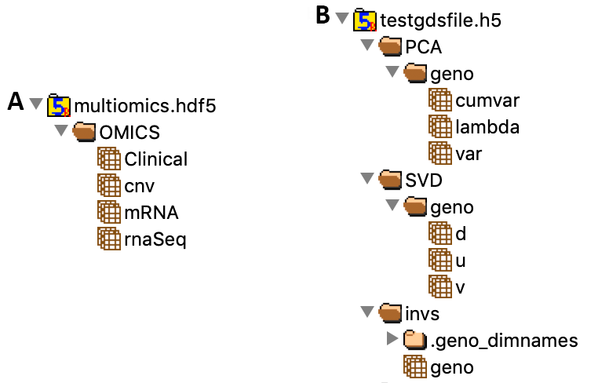


HDF5 data files
HDF5 (Hierarchical Data Format)
Created by HDF Group Fortner (1998)
Current versión HDF5
Format for Genomic Data
Store homogeneous multidimensional data sets organized in groups
Permits access to a specific datasets in a group.
Permits access to a specific position from dataset and read a block of data with user defined size.
rhdf5 library
h5 library
Data structure inside hdf5 file with BigDataStatMeth
Notes:
One of the procedures that we applied in order to optimize the memory was develop a library that could work with data on disk. The file type that we chose was the hierarchical data format, in its current version 5.
As we show in the upper image, hierarchical data files stores data organized (zd) in groups, inside a group, we can found other groups or different related (edd) datasets, with this datasets or groups we can also have associated (itt) metadata.
In the other image, in A panel we show how user can organize data referred (riferdd) to an experiment under a common group folder, here the data is organized under the group OMICS and inside this group we have Clinical data, mRNA, rna-Seq data and others data related to the same experiment.
In B panel we show how BigDataStatMeth organizes data inside a file after function execution, in that case, we have a original dataset with genomics data called “geno”, here we show how after perform a SVD with “geno” data, BigDataStatMeth automatically stores the results inside SVD folder, if we had SVD results from another dataset, that results would be under dataset name in SVD folder, the same procedure will be applied for other functions implemented in BigDataStatMeth like PCA.
Store results in the same file allows to reutilise (riúselize) results in the future, saving compute time, or allows us to share results with other researchers
To work with hierarchical data files we use different libraries some of them deployed (itt) by Bioconductor

Slide 10
Using Block-wise Algorithms for Scalability
A11 |  | A12
A21 |  | A22
20 | 21 | 22 | 23
24 | 25 | 26 | 27
28 | 29 | 30 | 31
32 | 33 | 34 | 35
C11 |  | C12
C21 |  | C22
1 | 2 | 3 | 4
5 | 6 | 7 | 8
9 | 10 | 11 | 12
13 | 14 | 15 | 16
B11 |  | B12
B21 |  | B22
*
=
A: Matrix (NxN)
B: Matrix (NxN)
C: new NxN matrix (initialized 0)
n: A.rows
for i in 1 to n
for j in 1 to n
for k in 1 to n
cij = cij + aik * bkj
return C
A
B
C
C11 |  | C12
C21 |  | C22
A11
*
B11
+
A12
*
B21
A11
*
B12
+
A12
*
B22
A21
*
B11
+
A22
*
B21
A21
*
B12
+
A22
*
B22

Slide 11
Block-wise Algorithms - Matrix Multiplication
A11 |  | A12
A21 |  | A22
20 | 21 | 22 | 23
24 | 25 | 26 | 27
28 | 29 | 30 | 31
32 | 33 | 34 | 35
C11 |  | C12
C21 |  | C22
1 | 2 | 3 | 4
5 | 6 | 7 | 8
9 | 10 | 11 | 12
13 | 14 | 15 | 16
B11 |  | B12
B21 |  | B22
*
=
A: Matrix (NxN)
B: Matrix (NxN)
C: new NxN matrix (initialized 0)
n: A.rows
for i in 1 to n
for j in 1 to n
for k in 1 to n
cij = cij + aik * bkj
return C
A
B
C
C11 |  | C12
C21 |  | C22
A11
*
B11
+
A12
*
B21
A11
*
B12
+
A12
*
B22
A21
*
B11
+
A22
*
B21
A21
*
B12
+
A22
*
B22

Slide 12
Block-wise Algorithms – SVD

Slide 13

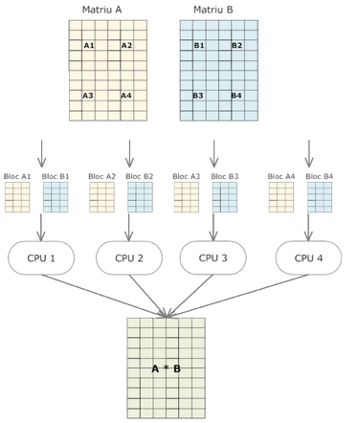
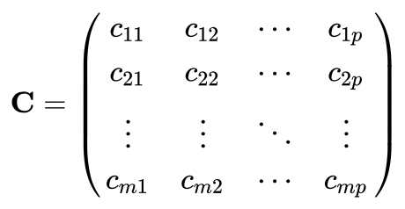
Integration in BigDataStatMeth
Availabe Programming Interfaces (APIs)
R interface API)
…
bdCreate_hdf5_matrix(filename= "hdf5_filename.hdf5",
object= a,group= "input",dataset= "datasetA", ... )
bdCreate_hdf5_matrix(filename= "hdf5_filename.hdf5",
object= b,group= "input",dataset= "datasetB", ... )
bdblockmult_hdf5(filename= "hdf5_filename.hdf5",
group= "input",A= "datasetA",B= "datasetB",
outgroup= "results",outdataset= "resmult",... )
…
Basic Functions
Lineal Algebra
Parallel computing
Matrix A
Matrix B
with :
OpenMP (OMP)
R Object
Rcpp library
C++ Data
HDF5 data file
h5 library
using functions from :
BLAS
Lapack
Spectra
RcppEigen
Rcpp
C++ native
Block A1
Block B1
Block A2
Block B2
Block A3
Block B3
Block An
Block Bn
C++ interface (API)
…
hdf5Dataset* dsA=new hdf5Dataset(filename,sgroup,A,false);
hdf5Dataset* dsB=new hdf5Dataset(filename,sgroup,B,false);
hdf5Dataset* dsC=new hdf5Dataset(filename,sgrpOut,ssOut,bforce);
BigDataStatMeth::multiplication(dsA, dsB, dsC,
block_size,mem_block,bparal,ithrs);
delete dsA;
delete dsB;
delete dsC;
…
Answer
CPU 1
CPU 2
CPU 3
CPU 4

Slide 14
Let's Practice!
Example – PCA with BigDataStatMeth)
Exercise – SVD with BigDataStatMeth

